Slide 1
This year’s calendar
How to understand it
How to calculate it
Michoel Reach

Slide 2
Contents
Introduction and overview
Choosing the calendar
Yomim Tovim and Sidros
Conclusion

Slide 3
Introduction
Maharsha: The Bnei Esav’s calendar only follows the sun, the Bnei Yishmael’s calendar only follows the moon – but the Torah requires us to follow both.
The Torah says that our calendar months should be set by the lunar cycle: החודש הזה לכם. A month begins with the sighting of the new moon. That happens approximately every 29 and a half days – but not exactly.
The Torah also requires that the calendar year stay in synch with the sun: Pesach must be בחודש האביב: in the spring. Sukkos must be חג האסיף, the gathering-in festival: in the fall. The solar year is approximately 365 and a quarter days - but not exactly.
These two time scales are independent, and are not multiples of one another. They are bound to get out of synch.

Slide 4
Introduction
For the first half of our history, the solution was to adjust them by hand:
Witnesses came to the Sanhedrin to establish the new month. Each month would be either 29 or 30 days long, whenever the new moon was sighted. Since a lunar month is about 29 and a half days, they added an extra day about half the time.
The Sanhedrin also decided each year whether to add Adar II, a thirteenth month, if it did not seem that spring would arrive before Pesach. A solar year is a third of a month (about 11 days longer) longer than twelve lunar months, so they needed to do that every few years.
In those days, there was no way to be sure ahead of time what the year’s calendar would be.

Slide 5
Introduction
By the days of Abaye and Rava it was very difficult to establish the months and years directly (Rambam: “no permanent court was left in Eretz Yisroel”), so the nasi Hillel ben Yehudah established a permanent calendar instead.
The Rambam says this is halacha l’Moshe b’Sinai. (Chazon Ish: the Rambam means doing it by calculation when needed – not the exact details.)
The current calendar is based only on calculation, not observation. It cannot be exact, but the approximate values chosen for month and year are close enough that it has drifted very slowly - days - in the hundreds of years since.
When we have a Sanhedrin again, we will be able to fix it.

Slide 6
References
Rambam, Hilchos Kiddush Hachodesh
Tur, Orach Chaim, 428. The chart there is the basis of the Keviyus web page.
Rabbi Nathan Bushwick, Understanding the Jewish Calendar, Moznayim, 1989.
Rav David Heber’s yearly shiur on the calendar at Yeshiva Ner Yisroel, Baltimore.
You can get this presentation and software tools at my website https://sites.google.com/site/miyminimichoel (along with other divrei Torah).

Slide 7
Overview
We are going to calculate the Jewish calendar for a year.
All we need to know is the number of the year. This year is תשע"ט – 5779.
Choose a calendar:
Decide if this is a regular year (פשוטה) or leap year (מעוברת).
Find the molad for this Tishrei.
Find the molad for the next Tishrei.
Find the calendar day for this Rosh Hashanah and for the next.
Choose the calendar.
Arrange the chosen calendar:
Find all the days of Rosh Chodesh, and all the yomim tovim.
Determine the Torah readings (סדרות).
Connect the calendar to the civil calendar.

Slide 8
Overview, cont. – choose a calendar
1) Decide if this is a regular year (פשוטה) or leap year (מעוברת).
The Torah requires the months to track the cycles of the moon.
The Torah requires the years to track the seasons of the (solar) year.
To keep them in synch, we sometimes add an extra month.
There is a repeating nineteen-year cycle of regular and leap years – (גו"ח אדז"ט).
The number of the year we are calculating tells us which one it is.

Slide 9
Overview, cont. – choose a calendar
2) Find the molad for this Tishrei
That is, the astronomical moment of the new moon for Tishrei of this year.
Chazal made the approximation that all months are exactly the same length, from one new moon to the next.
That amount is not an exact number of days; they estimated it within a second. (אי"ב תשצ"ג)
Knowing the number of years (and months) since Creation, knowing the starting point, and knowing the length of a month - calculate the moment of the molad.
This is an exact time, not a day.

Slide 10
Overview, cont. – choose a calendar
3) Find the molad for the next Tishrei
Repeat the process for the following year.
To the result for this Tishrei, add twelve more months worth of time (for a regular year) - or thirteen (for a leap year) - to get the molad for next year.
Again, this is an astronomical moment in time, not a day.

Slide 11
Overview, cont. – choose a calendar
4) Find the calendar day for each Rosh Hashanah.
Very often Rosh Hashanah will be on the same day as the time that the molad we calculated falls – but not always!
There are four situations that may cause it to be moved to the next day, or the day after.
These are known as the Four Dechiyos (ד' דחיות).
Each resulting Rosh Hashanah is a day of the week on the calendar now, not a moment in time.

Slide 12
Overview, cont. – choose a calendar
5) Choose the calendar
From the weekday of the first Rosh Hashanah, and the second, we know the length of the year. (חסירה, כסידרה, שלימה)
That length, plus the starting week-day, plus whether it’s a leap year or not, determines the full calendar.
There are only fourteen possible calendars.
Chazal already worked out every detail of each of them. We’re really done. The rest of the steps here will just describe how they did it.

Slide 13
Overview, cont. – arrange the chosen calendar
6) Find all the days of Rosh Chodesh, and all the yomim tovim.
Once we know whether the year is a regular or leap year, and which weekdays are Rosh Hashanah at the beginning and end, we know the total number of days in the year.
That tells us the lengths of each of the months, and gives us the days of Rosh Chodesh for each month.
Each of the yomim tovim is on a particular date in the calendar and is now determined as well.

Slide 14
Overview, cont. – arrange the chosen calendar
7) Determine the Torah readings (סדרות).
Now that the calendar is set up, we can see how many weekly Torah readings are needed – just count available Shabboses.
We decide how many parshiyos need to be doubled up to fit.
This was already done by Chazal for every possible calendar, but they gave some principles for how they decided which ones to double up.
The results can be different in Eretz Yisroel and in chutzah la’aretz.

Slide 15
Overview, cont. – arrange the chosen calendar
8) Connect the calendar to the English (civil) calendar.
We are not actually going to do this step – just explain it.
The קדמונים showed how to find the date when we start saying V’sein tal umatar, using the old Julian calendar.
Convert to today’s Gregorian calendar (used since 1582).
Use that to find any other date, like January 1.

Slide 16
Contents
Introduction and overview
Choosing the calendar
Yomim Tovim and Sidros
Conclusion

Slide 17
B) Choosing the calendar
Okay, let’s get started and really do it!
We’ll go through the steps to get the calendar for a year - and do it for this year.
Peshuta or m’uberes?
Introduction – how to calculate the molad
Find the molad - for Tishrei this year - and for next year
Find Rosh Hashanah - the four dechiyos
Choose the calendar

Slide 18
1) Peshuta or m’uberes?
 | This year:
The regular years (peshutos) and leap years (m'ubaros) are in a repeating nineteen year cycle. 7 leap years plus 12 regular months is 235 months. 235 lunar months is very close to 19 solar years. | 7x13 + 12x12 = 235 235 months - 19 solar years = about two hours
Take the number of the year, take the remainder divided by 19. | 5779 mod 19 = remainder 3
The siman גו"ח אדז"ט tells which ones are leap years: 3,6,8,11,14,17,19. | So this year is “ג”, a leap year (מעוברת).

Slide 19
B) Choosing the calendar
Peshuta or m’uberes?
Introduction – how to calculate the molad
Find the molad - for Tishrei this year - and for next year
Find Rosh Hashanah - the four dechiyos
Choose the calendar

Slide 20
2) Introduction – how to calculate
We use day of the week (1-7), hours, chalakim (reverse order in Hebrew).
All our calculations use this triplet of numbers.
The hours are measured starting from 6 pm (not the more usual שעות זמניות, which are based on sunrise and sunset or darkness), so 18 = 12 noon, etc.
1 chelek = 3⅓ sec., 1080 chalakim = 1 hour, 24 hours = 1 day.
Also 7 days = 1 week. But – We don't normally need to worry about the weeks at all. Chazal set it up that it’s enough to determine the time for the molad within the week.

Slide 21
How to calculate - standard shifts
Basic procedure: 1) Find how many months there are, from creation till the molad of this year’s Tishrei. Remember that some years are leap years and some regular years. 2) From the calendar’s starting point, add the time for that many months. 3) Now: what day of the week and time of day is that? Again: there have been thousands of weeks since creation, but we are only going to need to know the day of the week and the time of day. This is part of Chazal’s design to make things simpler.
Instead of counting all those months, we can break the job into pieces: 1) 19-year cycles, 2) additional regular years, and 3) additional leap years.

Slide 22
How to calculate - standard shifts, cont.
The starting point is set near the beginning of the _year_ one, but at בהר"ד: Monday, 5 hours, 204 chalakim.
Amazingly enough, this is an imaginary time, before the world was created! Chazal could have started from their own time, call it 4200, and gone forward – but then you would have had to subtract 4200 from the number of this year in the calculations.
For convenience, they tracked backward in time to zero, so you wouldn’t have to subtract.
The time בהר"ד is arbitrary, just matches with whenever they really started. But adding one year to it, you do get Friday morning of Tishrei the next year, year 2, when First Man was created.

Slide 23
How to calculate - standard shifts, cont.
To the starting point, we’ll add multiples of the following four shifts.
One molad – shift for one lunar month = אי"ב תשצ"ג: 1 day (really 29 days - but we ignore the weeks), 12 hours, 793 chalakim
Shana peshutah – built out of 12 of these months = ד"ח תתע"ו: 4 days, 8 hours, 876 chalakim
Shana m'uberes - built out of 13 of these months = הכ"א תקפ"ט: 5 days, 21 hours, 589 chalakim
19 year cycle - 19 years with 7 m'ubaros and 12 peshutos = בי"ו תקצ"ה: 2 days, 16 hours, 595 chalakim.
Each of these tells how far the molad moves after that many months. No weeks!

Slide 24
How to calculate - example
If you'd want to add 4 days, 18 hours, 443 chalakim (די"ח תמ"ג) or (ד, יח, תמג) to 5 days, 20 hours, 742 chalakim (ה, כ, תשמב):
443+742 = 1185 = 1 hour (=1080 chalakim) + 105 chalakim.
18 + 20 + 1 (which was carried) = 39 = 1 day + 15 hours.
4 + 5 + 1 = 10 = 1 week (ignore) + 3 days.
The result: 3 days, 15 hours, 105 chalakim (ג, טו, קה).
This is how all these calculations are done. Just keep carrying.

Slide 25
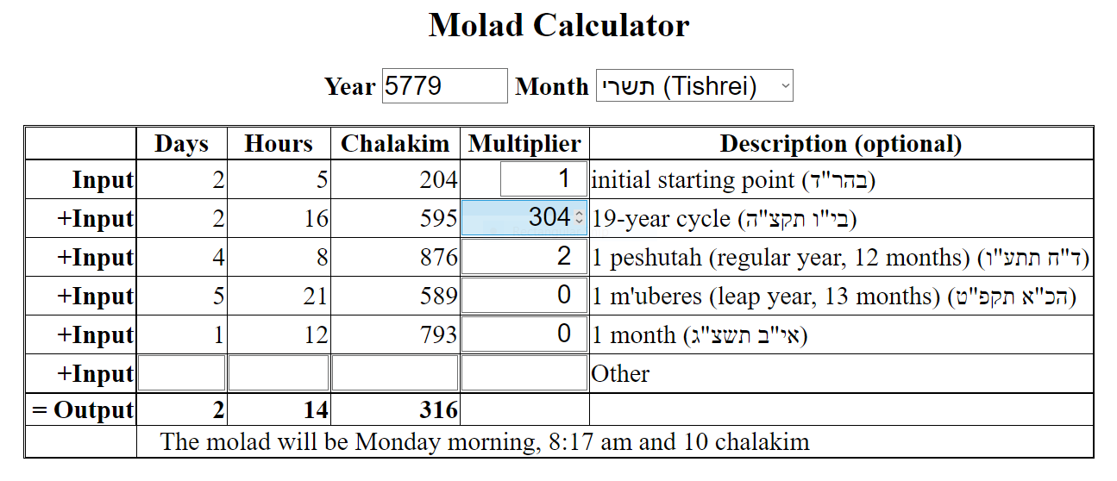
Calculator
So you don’t have to do this yourself:

Slide 26
B) Choosing the calendar
Peshuta or m’uberes?
Introduction – how to calculate the molad
Find the molad - for Tishrei this year - and for next year
Find Rosh Hashanah - the four dechiyos
Choose the calendar

Slide 27
3) Find the molad for this year’s Tishrei
(If you know last year's molad it's easier, start from there. Otherwise,) | This year:
The starting point is the year zero, בהר"ד (Monday, 5 hours, 204 chalakim | (2,5,204)
Find the number of 19 year cycles | 5779\19 = 304 19-year-cycles
Add (the number of 19 year cycles) * (the shiftבי"ו תקצ"ה , for each one) | 304 * (2,16,595) = (5,15,520)

Slide 28
3) Find the molad for this year’s Tishrei, cont.
 | This year:
Using גו"ח אדז"ט, see how many peshutos (P) and how many m'ubaros (M) there have been already in this cycle. | 5779#19 = remainder 3, so 2 peshutos so far, no m'ubaros. P=2, M=0.
Add the shift for each: (P * ד"ח תתע"ו) + (M * הכ"א תקפ"ט) | (2*(4,8,876)) + (0*(5,21,589)) = (1,17,672)
Add _all of these_ [i.e., the results of 1., 3., and 5.] up for this year’s molad | = (2,14,316)
Remember – we don’t care about the weeks! | (On the Calculator, you would enter multipliers 1, 304, 2, 0, 0, 0 to get this result.)

Slide 29
3) Find the molad for this year’s Tishrei, cont.
 | This year:
If you actually want the molad for a different month, say for announcing the molad in shul, also add the number of additional months * אי"ב תשצ"ג | Say for Cheshvan for this year: 1 additional month, so add (1,12,793) to the (2,14,316) we got for Tishrei. = (4,3,29) = Wednesday, 9 pm [3 hours after 6 pm], 29 chalakim.
 | (On the Calculator, the multipliers are now 1, 304, 2, 0, 1, 0.)

Slide 30
3) Repeat: Find the molad for next year’s Tishrei
 | This year:
Add one more year's shift, either peshutaד"ח תתע"ו) ) or m'uberesהכ"א תקפ"ט) ) whichever this year is. | 5779#19 = remainder 3. 3rd year, add one m'uberes shift (5,21,589) to (2,14, 316) from above = (1,11,905)
 | (On the Calculator, the multipliers are now 1, 304, 2, 1, 0, 0.)
We now have the molad for Tishrei this year, and next year. They are exact times, not days. | This year and next year: (2,14,316) and (1,11,905)

Slide 31
B) Choosing the calendar
Peshuta or m’uberes?
Introduction – how to calculate the molad
Find the molad - for Tishrei this year - and for next year
Find Rosh Hashanah - the four dechiyos
Choose the calendar

Slide 32
4) Find Rosh Hashanah – the four dechiyos
 | This year:
For the actual calendar, we need to find the day of the week (of the first day) of each of the two Rosh Hashanos - not just the time of the molad. Normally each Rosh Hashanah is on that day of the week when its molad was. | This time, those days would be: Monday for this year (from 2,14,316 calculated above), and Sunday for next year (from 1,11,905 calculated above)
Not always! – In four situations either one is moved later. This is pretty common.

Slide 33
4) Find Rosh Hashanah – the Four Dechiyos
The ד' דחיות where they are moved later (never earlier):
מולד זקן
לא אד"ו ראש
ג"ט ר"ד
בט"ו תקפ"ט

Slide 34
4a) The four dechiyos - מולד זקן
 | This year:
For each Rosh Hashanah’s molad, is the hour after noon (18 hours in our system that measures from 6pm)? If so, move it to the next day. | (2,14,316), (1,11,905): neither of these is after noon.

Slide 35
4b) The four dechiyos - לא אד"ו ראש
 | This year:
After you did the first dechiyah:
For each Rosh Hashanah, is the day now Sunday, Wednesday, or Friday? (אד"ו = 1, 4, 6) | This year’s RH (2,14,316) is on Monday, it doesn’t change.
If so, move it to the next day. Those days are not allowed. By now, we may have moved Rosh Hashanah two days. | Next year's RH (1,11,905) is on Sunday – not allowed - so it moves up to Monday instead.
 | Both are now on Monday.

Slide 36
4) The four dechiyos, cont.
Last two dechiyos – ג"ט ר"ד and בט"ו תקפ"ט
There are two more rules ("dechiyos") that have to do with the length of the calendar year.
Some background first:
Chazal only allowed three lengths to a year: short (חסרה), medium (כסדרה), and long שלמה)).
Chaseirah is one day shorter than k'sidrah, sheleimah is one day longer. (We'll see how this works when we talk about the lengths of the months.)
By comparing the day of this year's Rosh Hashanah to next year's, you can tell which it is.

Slide 37
Length of year - פשוטה
The actual calendar doesn’t use times, i.e. hours and chalakim, just complete days.
We saw that a regular year (פשוטה) has a molad shift of ד"ח תתע"ו: 4 days and 8+ hours.
In the actual calendar - which uses days, not times - a short chaseirah year (353 days) has a shift of three days from one Rosh Hashanah to the next, say from Shabbos this year to Tuesday the next.
A regular k'sidrah year (354 days) has a four day shift, and a long sheleimah year (355 days) has a five day shift.
These are all the choices that are allowed.

Slide 38
Length of year - מעוברת
A leap year (מעוברת) we saw earlier has a molad shift of הכ"א תקפ"ט: 5 days, 21+ hours. That was a shift in time-of-day within the week.
In the actual calendar, a chaseirah leap year (383 days) has a shift of five days from one Rosh Hashanah to the next (such as from Monday to Shabbos).
A k'sidrah (384) has a six day shift.
A sheleimah (385) has a seven day shift - that is, the two Rosh Hashanos are on the same day of the week.
These are all the choices that are allowed.

Slide 39
Length of year - summary
 | שלימה | כסידרה | חסירה
פשוטה | 5 day shift (355 days) | 4 day shift (354 days) | 3 day shift (353 days)
מעוברת | 7 day shift (385 days) | 6 day shift (384 days) | 5 day shift (383 days)
You see now why we never worry about the weeks. That’s the easy part; we really just need to figure out the days: that tells us which of these it is.

Slide 40
4c) The four dechiyos – ג"ט ר"ד
 | This year:
Okay! When you do the first two dechiyos, you can find that the second one moved forward too far, so the stretched year ends up one day longer even than a "sheleimah" – not allowed. You fix it by moving the first RH forward as well. This turns out to happen in only one case: a regular פשוטה year, when the molad falls on Tuesday, after 9 hours, 204 chalakim (therefore called ג"ט ר"ד)). But then RH moves two days forward, as it can't fall on Wednesday either (rule (2), לא אד"ו ראש). For the second Rosh Hashanah, the same, but there you’d need to see if next year is a פשוטה. | Not this year. It last happened in 5772.

Slide 41
4d) The four dechiyos - בט"ו תקפ"ט
 | This year:
In the reverse direction, you can find that the first Rosh Hashanah moved forward too far, and the squished year is one day shorter even than a "chaseirah" - too short. You fix it by moving the second Rosh Hashanah forward one day as well. It turns out this also only happens in one case: a leap year (מעוברת), and only when the second molad falls on Monday, after 15 hours, 589 chalakim (therefore called בט"ו תקפ"ט). That Rosh Hashanah gets moved to Tuesday. For the first Rosh Hashanah, the same, but it would depend on last year being a leap year. | Not this year. It last happened Rosh Hashanah 5766 (at the end of 5765) – and never again till the year 6000. It happens very rarely.

Slide 42
4) The four dechiyos, cont.
 | This year:
After applying these four rules, where applicable, we have the day of the week for Rosh Hashanah, at both the beginning and the end of the year. | This year is a leap year (מעוברת). Both Rosh Hashanos (i.e., the first day of Rosh Hashana) this year ended up on Monday, so the year is long (שלימה).

Slide 43
B) Choosing the calendar
Peshuta or m’uberes?
Introduction – how to calculate the molad
Find the molad - for Tishrei this year - and for next year
Find Rosh Hashanah - the four dechiyos
Choose the calendar - The Kevius page - Find this year’s calendar

Slide 44
Choose the calendar
We can now choose the calendar for the year.
It turns out there are only fourteen possible calendars, total: seven for regular years, seven for leap years.
To help visualize this, this is a chart in the Tur, Orach Chaim, 428.

Slide 45
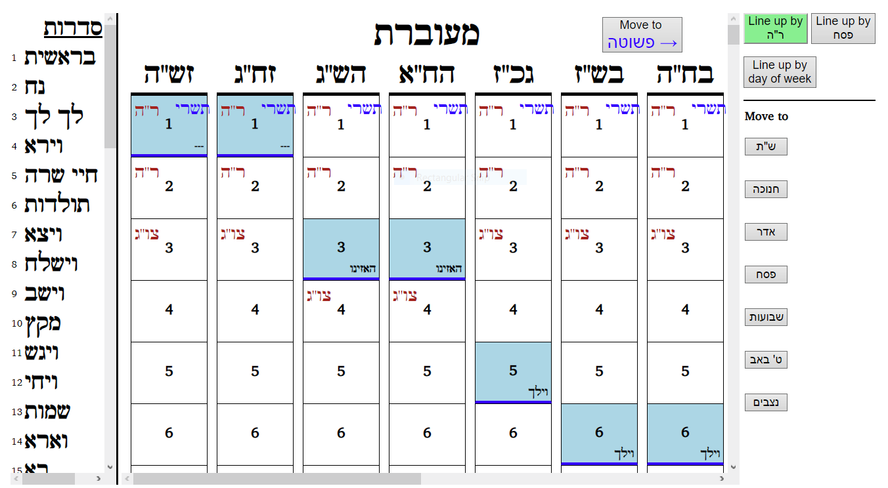
Choose the calendar – the Keviyus page
A maybe fancier version of that chart:

Slide 46
B) Choosing the calendar
Peshuta or m’uberes?
Introduction – how to calculate the molad
Find the molad - for Tishrei this year - and for next year
Find Rosh Hashanah - the four dechiyos
Choose the calendar - The Kevius page - Find this year’s calendar

Slide 47
Choose the calendar – find this year’s calendar
 | This year:
There are only 14 choices, 7 for regular years, 7 for leap years. First choose the correct side - regular or leap year. Resize so all 7 for that side are visible. | This year is a leap year. If the page header is פשוטה, click on the right-hand pane and scroll left, or click the “מעוברת” button.
Choose the correct calendar from those seven. The first letter in the title at the top is the day of the week of the initial Rosh Hashanah. The second is “ח” for chaseirah, “כ” for k'sidra, “ש” for sheleimah. | Rosh Hashanah at the beginning of this year is Monday -ב , the year is sheleimah. So the title should begin withבש . That matchesבש"ז : the second one from the right.

Slide 48
Choose the calendar, cont. – ארבעה שערים
The “Four Gates”: Chazal found a way to mechanize the process of picking a calendar, to handle the ד' דחיות automatically.
All you need is (a) the molad of this Rosh Hashanah, and (b) which of last year, this year, and next year are m’ubaros.
Then you look up the answer on the chart. The ד' דחיות are built in.

Slide 49
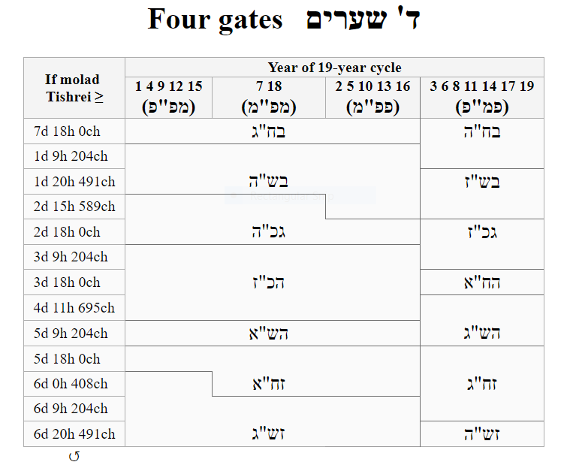
(2d 14h 316ch)

Slide 50
Contents
Introduction and overview
Choosing the calendar
Yomim Tovim and Sidros
Conclusion

Slide 51
C) Yomim Tovim and Sidros
Establish the months
Yomim tovim
Sidros - Introduction - Arranging the sidros

Slide 52
Establish the months
We have our calendar. Now we determine the length of each of the months.
Months can be either 29 days (חסר) with one day of Rosh Chodesh at the end, or 30 days (מלא), ending with two days of Rosh Chodesh.
If there are two, the first day of Rosh Chodesh is the 30th day of the previous month. The last day of Rosh Chodesh is always the 1st of the next month.
The months must combine to form the right length year: as we saw, 353, 354, or 355 for a regular year, 383, 384, or 385 for a leap year.
Most months have a specific length, never vary. Roughly, they alternate:
Tishrei 30, Teves 29, Shvat 30, Adar 29, Nisan 30, Iyar 29, Sivan 30, Tammuz 29, Av 30, Elul 29 – always.
In a leap year, Adar I is added with 30 days and Adar II has 29.

Slide 53
Establish the months, cont.
 | This year:
Only two months, Cheshvan and Kislev, can vary: either 29 or 30 days. That's the three-day range for the length of the year. In a chaseirah both Cheshvan and Kislev are 29. In a k'sidrah Cheshvan is 29 and Kislev 30. In a sheleimah both are 30. If you know (a) if it's a leap year, and (b) if it’s chaseirah, k'sidrah, or sheleimah, you can establish all the months. | This year is a leap year and a sheleimah. So the sequence this year is Tishrei 30, Cheshvan 30, Kislev 30, Teves 29, Shvat 30, Adar I 30, Adar II 29, Nisan 30, Iyar 29, Sivan 30, Tammuz 29, Av 30, Elul 29. Total days: 385

Slide 54
C) Yomim Tovim and Sidros
Establish the months
Yomim tovim
Sidros - Introduction - Arranging the sidros

Slide 55
Yomim Tovim
 | This year:
We’ve already added the Roshei Chodoshim to the calendar. Each of the other yomim tovim has a fixed date in the calendar - that gives its day of the week. Special cases: | Scroll down through calendar בש"ז to see where this year’s yomim tovim fall.
Chanukah is always eight days, whether Rosh Chodesh Teves is one day or two, so Chanukah may end on 2 Teves or 3 Teves. | This year Rosh Chodesh Teves is two days, so Chanukah ends on 2 Teves.
Fast days get pushed forward if they fall on Shabbos. | 17 Tammuz and Tisha B’Av fall on Shabbos this year, so the actual fasts are on Sunday.

Slide 56
Establish the months, cont.
We saw that only three things vary in the calendar (aside from which day you start): Cheshvan, Kislev, and whether there’s a second Adar.
What that means: The entire calendar from the last Adar onward is always the same. From Adar II and Purim, Nisan and Pesach, all the way through the next Rosh Hashanah (really right through Cheshvan) is an identical rigid span for all calendars (just shifted by the day it starts).
The result: If you know the day of the week for any one of those days, you know all the rest.

Slide 57
Establish the months, cont.
“If you know the day of the week for any one of those days, you know all the rest.”
See Tur Orach Chaim 428 for a mnemonic using this (“את-בש"):
1st day of Pesach (א) same day as Tisha B’Av (ת)
2nd day of Pesach (ב) same day as Shavuos (ש)
3rd day of Pesach (ג) same day as Rosh Hashanah (ר)
4th day of Pesach (ד) same day as Krias HaTorah (Simchas Torah) (ק)
5th day of Pesach (ה) same day as Tzom (Yom Kippur) (צ)
6th day of Pesach (ו) same day as the previous Purim (פ)

Slide 58
Establish the months, cont.
 | This year:
Remember the last letter of the calendar’s title (not in the Tur’s chart, but common since then)?
That letter indicates the day of the week when Pesach falls. That day is actually determined by the first two, and is just given for convenience. One result of it is that all fourteen calendars have unique titles. Using the Tur’s א"ת ב"ש, it gives us a lot of other yomim tovim as well. | This year Pesach begins on Shabbos (ז), as you can see by scrolling down on that calendar. So the correct calendar is titled בש"ז.

Slide 59
C) Yomim Tovim and Sidros
Establish the months
Yomim tovim
Sidros - Introduction - Arranging the sidros

Slide 60
Sidros - introduction
On the home stretch!
The last major job: we need to place the Sidros (parshiyos). It should be easy - they're in order!
Three things make things more complicated.
Yomim Tovim
Counting parshiyos
Eretz Yisroel and chutzah la’aretz

Slide 61
3a) Yomim Tovim
If the major yomim tovim fall on Shabbos, they have their own reading - and the weekly sidrah waits for the next week.
This applies to: Rosh Hashanah, Yom Kippur, all of Sukkos, all of Pesach, and Shavuos.
Sukkos and Pesach can contain one or two Shabboses.

Slide 62
3b) Counting parshiyos
Depending on
when Rosh Hashanah falls at the beginning and end of the year, and
how many yomim tovim interrupt,
we find the total numbers of weekly readings that year. Count.
There are 54 sidros (see the left-hand pane in the Keviyus page). Some may need to be doubled up, to fit the actual number of readings.
[One of them is V’zos Habracha, and it is read on Simchas Torah – doesn’t count.]
There are (about) four more weeks in a leap year (מעוברת) than in a regular year (פשוטה), so a regular year will need several more double parshiyos.

Slide 63
3b) Counting parshiyos, cont.
The left pane on the Keviyus web page shows which sidros can be doubled – but not how to decide which ones actually are.
Chazal did this in stages, going from one benchmark to another through the year.
We’ll need to know how many Shabbos readings there are between each pair of benchmarks. It may vary with the different calendars.
How far apart are the benchmarks? – this many weeks, this many extra days. Each week is one reading. As for the extra days, it depends whether Shabbos falls in between.

Slide 64
3c) Eretz Yisroel and chutzah la’aretz
The one-day yomim tovim in Eretz Yisroel can mean that the second day of yom tov falls on Shabbos, and takes over the Torah reading in chutzah la’aretz -
but not in Eretz Yisroel.
That would mean that Eretz Yisroel has room for an extra parsha that year, compared to chutzah la’aretz. It will jump a week ahead then, and stay ahead until chutzah la’aretz has a double parsha and Eretz Yisroel not.

Slide 65
Sidros, cont.
 | This year:
Scroll down your calendar for the year and see
where the parshiyos get pushed away by the major Yomim Tovim | בש"ז leap year. On Shabbos: Chol Hamoed Sukkos, first day of Pesach - and the last day but only in chutzah la’aretz.
and how many times they need to be doubled to make things fit – to use all 54 sidros. | It turns out we are going to need one double parsha in chutza la’aretz (Matos-Masei) – and none at all in Eretz Yisroel.

Slide 66
C) Yomim Tovim and Sidros
Establish the months
Yomim tovim
Sidros - Introduction - Arranging the sidros

Slide 67
Sidros – Arranging the sidros
We do this in stages, working between benchmarks.
Beginning the year
Pesach
Shavuos
Tisha B’Av
Nitzavim-Vayeilech
Plus - some changes between Eretz Yisroel and chutzah la’aretz
(A fuller description is in the separate Sidros.pptx)

Slide 68
1) Arranging the sidros – beginning the year
 | On Keviyus page:
No sidros are ever combined until Adar - in olden times they wouldn’t know till then if it would be a leap year! | Scroll down to Adar It can help to open two calendars, side by side.
In a regular year we need to catch up about four weeks, so in a leap year all of Vayakhel-Pekudei, Tazria-Metzora, Acharei-Kedoshim, Behar-Bechukosai are separate. | Go from פשוטה years to מעוברת years (right to left) and compare – Nisan on one side, Adar II on the other.
But three of these pairs are after Pesach. So regular years won’t catch up to leap years until around Shavuos. | Scroll to Pesach and Shavuos, checking both sides.

Slide 69
2) Arranging the sidros – Pesach
 | On Keviyus page:
Parshas Tzav is always right before Pesach for a peshutah. | Check this for all calendars.
This usually requires Vayakhel-Pikudei to be doubled: it’s the only double parsha before Tzav. | It can help to open two calendars, side by side – one near Simchas Torah, the other near Pesach.
A leap year has (at least) 4 extra Shabboses. There are no double parshiyos before Pesach. You get to Parshas Metzora, or Acharei Mos, before Pesach. | On some leap years, you just run out of room – you can’t help getting to Parshas Acharei Mos without any double parshiyos at all.

Slide 70
3) Arranging the sidros – Shavuos
 | On Keviyus page:
There are exactly six Shabboses between Pesach and Shavuos. | Scroll to show them. (It’s easiest to use Line up by Pesach from here on.)
The regular years catch up now, with Tazria-Metzora, Acharei Mos-Kedoshim, Behar-Bechukosai. Both kinds of year get to Parshas Bamidbar just before Shavuos. | See the regular years catch up.
For some leap years we were already a week ahead before Pesach, so we can’t help getting to Parshas Naso instead before Shavuos. | For the calendars starting with Thursday (ה), scroll to see how it stays a week ahead.

Slide 71
4) Arranging the sidros – Tisha B’Av
 | On Keviyus page:
This is where we catch up completely.
Parshas Devarim is always right before Tisha B’Av. That’s 10 sidros from Bamidbar (9 from Naso). | In left-hand pane, see Bamidbar to Devarim.
If there are 8 Shabboses after Shavuos, we need to combine two sets of sidros. If there are 9 Shabboses after Shavuos, we’ll only combine one set of sidros. If we reached Naso before Shavuos, we may not combine either. | The two sets are Chukas-Balak, Matos-Masei. If just one, Matos-Masei.

Slide 72
5) Arranging the sidros – Nitzavim-Vayeilech
 | On Keviyus page:
Parshas Nitzavim is always right before Rosh Hashanah. That leaves Vayeilech and Ha’azinu. V’zos Habrocha is on Simchas Torah, doesn’t count. | From Devarim to Nitzavim is seven sidros, in seven weeks, for all calendars.
There is exactly 1 Shabbos between Rosh Hashanah and Yom Kippur. If Rosh Hashanah falls on Monday or Tuesday, there is another Shabbos between Yom Kippur and Sukkos. If so, Vayeilech will be needed for Shabbos Shuvah, and Ha’azinu before Sukkos. Otherwise, Nitzavim-Vayeilech is doubled. | When there’s a Shabbos between Yom Kippur and Sukkos, see (at the end of the calendars) how that adds an extra parsha. Doesn’t matter if the year is פשוטה or מעוברת.

Slide 73
6) Eretz Yisroel and chutzah la’aretz
 | On Keviyus page:
Only two days can be a Yom Tov in chutzah la’aretz and chol in Eretz Yisroel: Acharon shel Pesach and the second day of Shavuos. [Chol Hamoed overrides the leining anyhow, and Shemini Atzeres never falls on Friday.] | For headers ending with ז“__ (such as this year, בש"ז) it starts with Acharon shel Pesach. For headers ending with ה“__ it starts with Shavuos.
When that happens, Eretz Yisroel is a week ahead of chutzah la’aretz till we get a double parsha in chutzah la’aretz and not in Eretz Yisroel. | Follow the sidros till they rejoin. They don’t always rejoin first chance they get.

Slide 74
Contents
Introduction and overview
Choosing the calendar
Yomim Tovim and Sidros
Conclusion
The civil calendar
Acknowledgements

Slide 75
The civil calendar
One step remains – matching our Hebrew calendar with the civil (English) calendar.
We aren’t going to go through it in detail.
The Rishonim (Rambam, Tur, etc.) did not bother with this at all.
It has become important in the last few centuries, as our connection with the non-Jewish society has grown, especially if we use the non-Jewish calendar for everyday living.
Easiest way is to keep track from last year!

Slide 76
The civil calendar, cont.
The Rishonim did explain a related task: when to start saying ותן טל ומטר in חו"ל, 60 days after the autumnal (fall) equinox – a solar date.
The calculation [“תקופת שמואל”] corresponds to the Julian calendar, where a year is exactly 365.25 days – a civil leap year (on Feb. 29) every four years.
That was replaced in 1582 by today’s Gregorian calendar, which has a more complex rule for leap years. They also did a one-time 11-day adjustment to get back in synch with the sun.
You currently end up with Dec. 4th (or 5th in a civil leap year).
Once that date is calculated, you can find all other corresponding civil dates. For example, Dec. 4 is the 338th day of the solar year, 337 days from Jan. 1.

Slide 77
D) Conclusion
This year’s calendar is complete. Do it again next year!
Thanks for watching!

